Slide 1
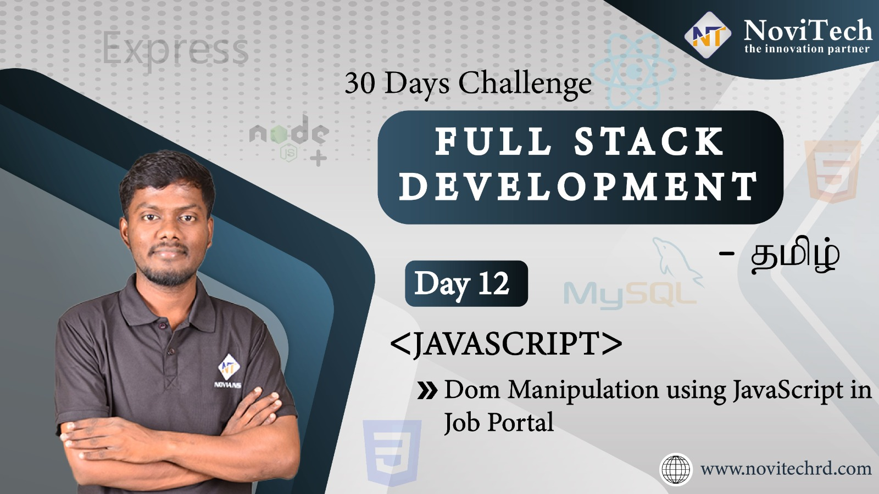

Slide 2

Announcement
ATTENDANCE LINK will be shared in between session
Minimum 28 DAYS Attendance required to receive your
FREE E-CERTIFICATE

Slide 3
Prerequisites
Laptop with Internet Connection
No Prior Knowledge is required
Note & Pen

Slide 4


Slide 5

Introduction

Slide 6
DOM
Document
Object
Model
Files
Tags, Elements
Layout, Structure
Ex:html,xml
Ex:<h1><img>
Ex:Layout of that structure

Slide 7
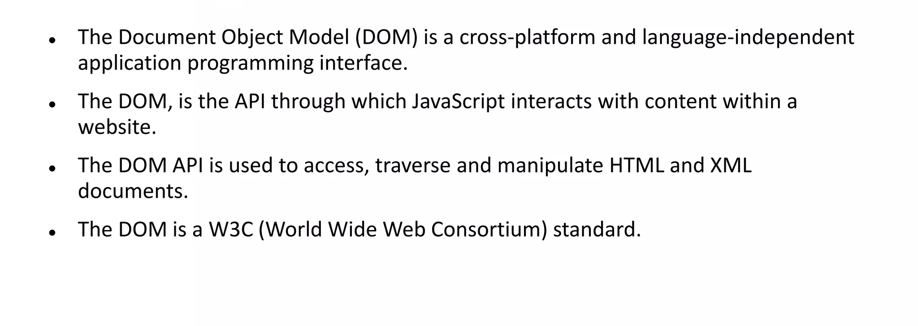
What is DOM

Slide 8
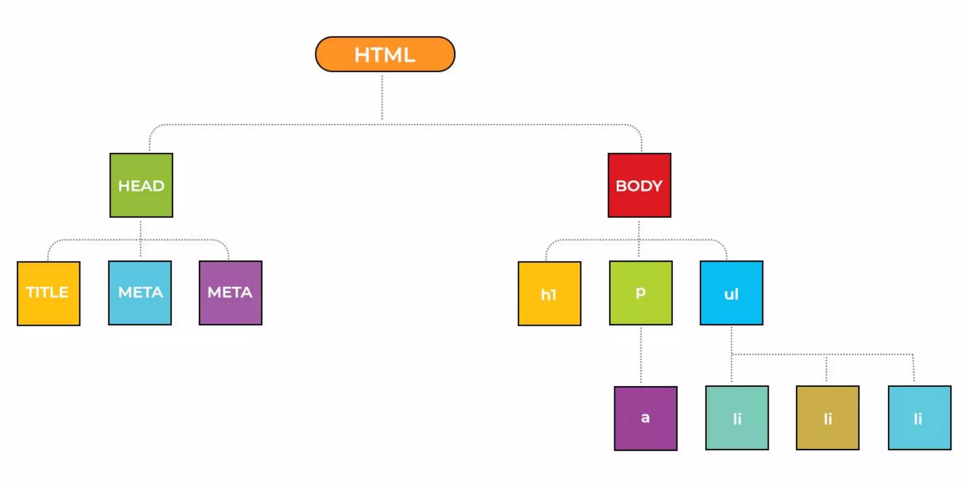
HTML DOM Tree Objects

Slide 9
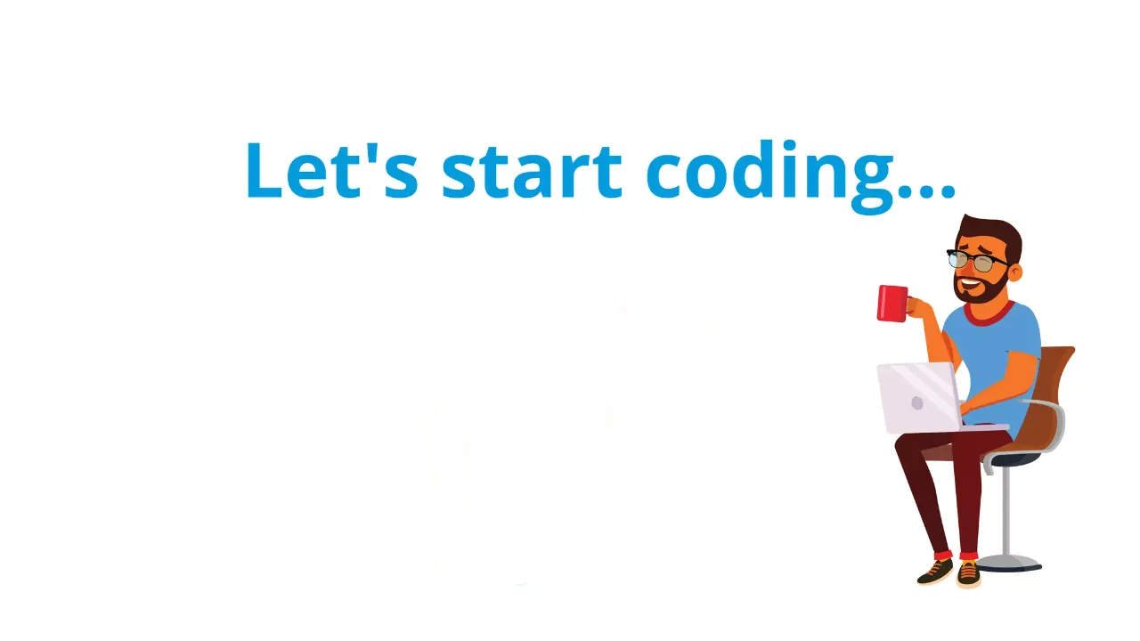

Slide 10



Slide 11

wonder word
CALM

Slide 12
RESOLUTION
MORNING WAKE UP 6-7 AM
LEARNING NEW TECHNOLOGY
HEALTH AND FITNESS
DAILY READING
FINANCIAL WELNESS
CONTINOUS LEARNING AND SKILL DEVELOPMENT

Slide 13




THANK YOU☺
JOIN WhatsApp community
novitechresearchanddevelopment

Slide 14

Post Your Attendance

Slide 15


